Slide 1
Parallel and Distributed Computation OpenMP
Kun Suo
Computer Science, Kennesaw State University
https://kevinsuo.github.io/

Slide 2
Outline
OpenMP introduction
Helloworld of OpenMP
Performance evaluation
Example: how to solve problems in OpenMP
Trapezoidal problem

Slide 3
OpenMP
MP = multiprocessing
An API for shared-memory parallel programming.
https://www.openmp.org/

Slide 4
Distributed Memory
Each processor has its own memory
Parallel programming by message passing (MPI)

Slide 5
Shared Memory
Processors shared memory
Parallel programming approaches
message passing (MPI)
pthread
directives-based interface - OpenMP

Slide 6
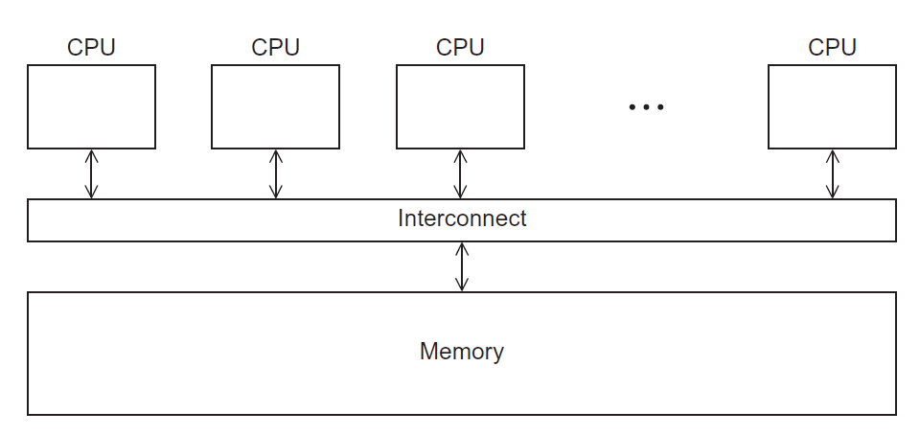
OpenMP
Designed for systems in which each thread or process can potentially have access to all available memory.
System is viewed as a collection of cores or CPU’s, all of which have access to main memory.

Slide 7
Pros and Cons Of OpenMP
Pros
Prevalence of multi-core computers
Requires less code modification than using MPI
OpenMP directives can be treated as comments if OpenMP is not available
Directives can be added incrementally

Slide 8
Pros and Cons Of OpenMP
Cons
OpenMP codes cannot be run on distributed memory computers (exception is Intel's OpenMP)
Requires a compiler that supports OpenMP (most do)
limited by the number of processors available on a single computer
rely more on parallelizable loops

Slide 9
Examples of Applications That Use OpenMP
Applications
MATLAB
Mathematica
https://www.wolfram.com/mathematica/

Slide 10
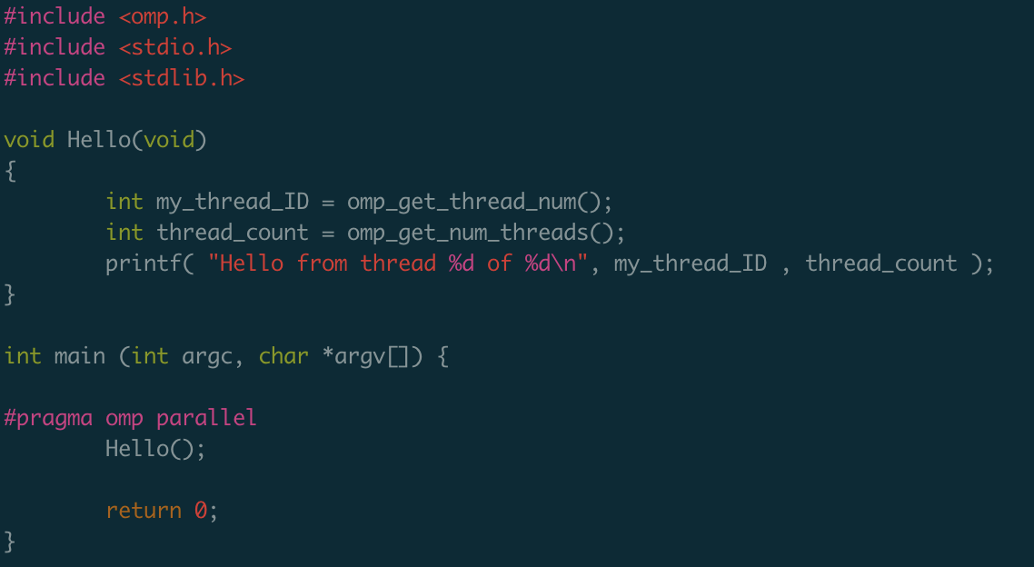
Example
https://github.com/kevinsuo/CS4504/blob/main/omp-helloworld.c
omp.h file
Return 0,1,2,3
Thread number is decided by core number

Slide 11
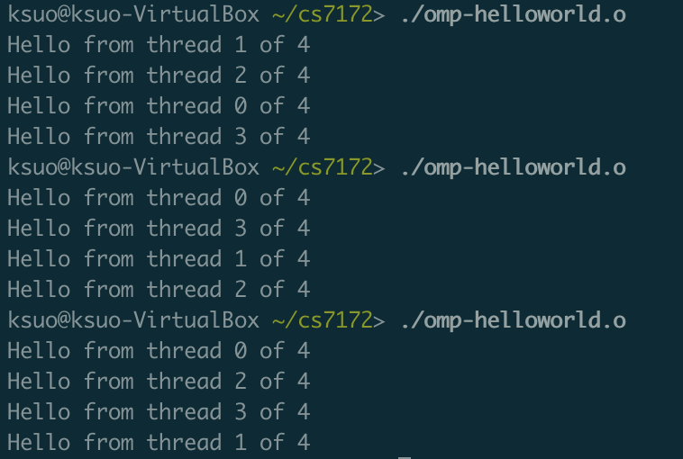
Example
Compile
gcc omp-helloworld.c -o omp-helloworld.o -fopenmp
Run
./omp-helloworld.o

Slide 12
Pragmas
https://github.com/kevinsuo/CS4504/blob/main/omp-helloworld.c
omp.h file
Return 0,1,2,3
Thread number is decided by core number

Slide 13
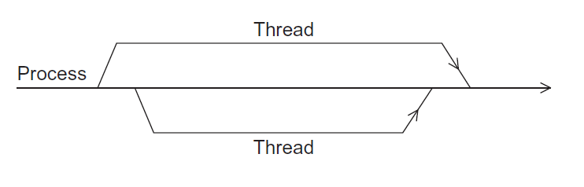
Example
https://github.com/kevinsuo/CS4504/blob/main/omp-helloworld.c
Master thread
worker thread
omp_get_thread_num
omp_get_num_threads
Get total number and rankID
#pragma omp parallel

Slide 14
Example
Compile
gcc -fopenmp omp-helloworld.c -o omp-helloworld.o
Hello from thread 0
Hello from thread 1
Hello from thread 2
Hello from thread 3
possible outcomes
Hello from thread 3
Hello from thread 1
Hello from thread 2
Hello from thread 0
Hello from thread 1
Hello from thread 2
Hello from thread 0
Hello from thread 3

Slide 15
How to Compile and Run an OpenMP Program
Compiler | Compiler Options | Default behavior for # of threads (OMP_NUM_THREADS not set)
GNU (gcc, g++, gfortran) | -fopenmp | as many threads as available cores
Intel (icc ifort) | -openmp | as many threads as available cores
Portland Group (pgcc,pgCC,pgf77,pgf90) | -mp | one thread

Slide 16
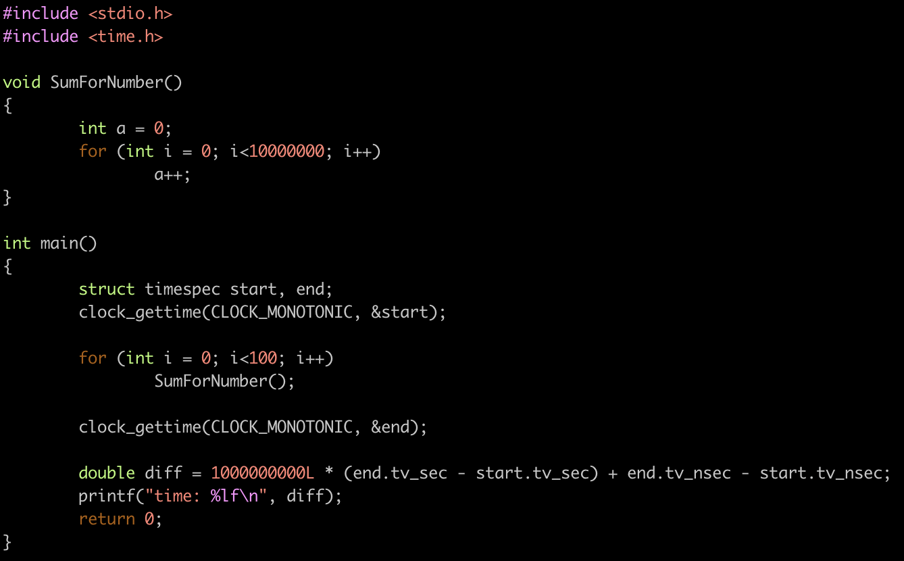

From Sequential to Parallel in OpenMP
https://github.com/kevinsuo/CS4504/blob/main/serial-code.c

Slide 17
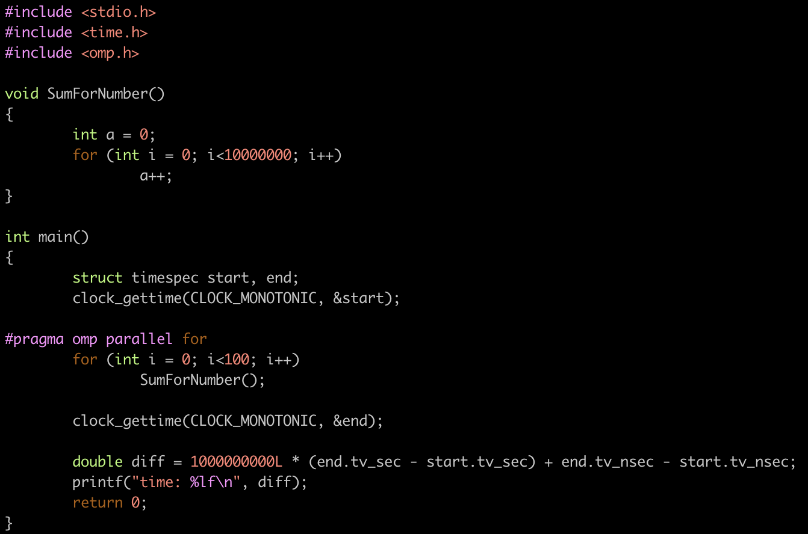


From Sequential to Parallel in OpenMP

Slide 18
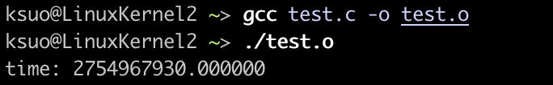
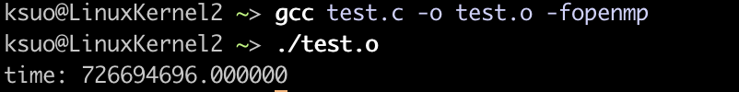

From Sequential to Parallel in OpenMP

Slide 19
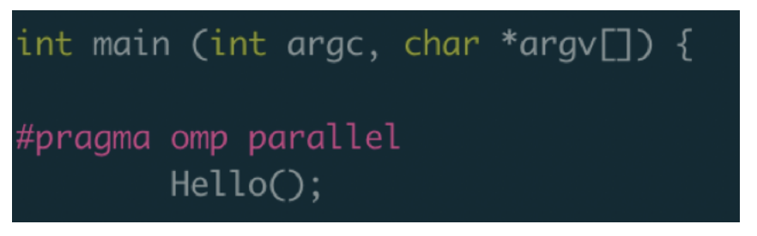
Clause: #pragma omp parallel
Each core creates one thread to execute the function
The number of thread is determined by runtime system

Slide 20
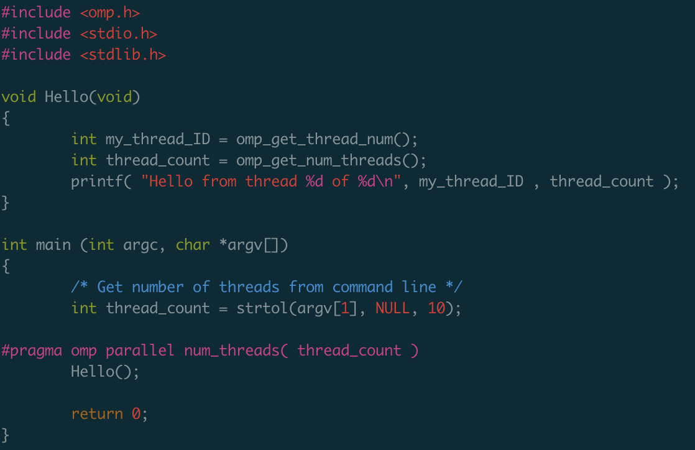



Example: #pragma omp parallel num_threads(thread_count)
https://github.com/kevinsuo/CS7172/blob/master/omp-helloworld-2.c
Thread number is decided by user input

Slide 21

Clause: #pragma omp parallel num_threads(thread_count)
The num_threads clause can be added to a parallel directive.
It allows the programmer to specify the number of threads that should execute the following block.

Slide 22
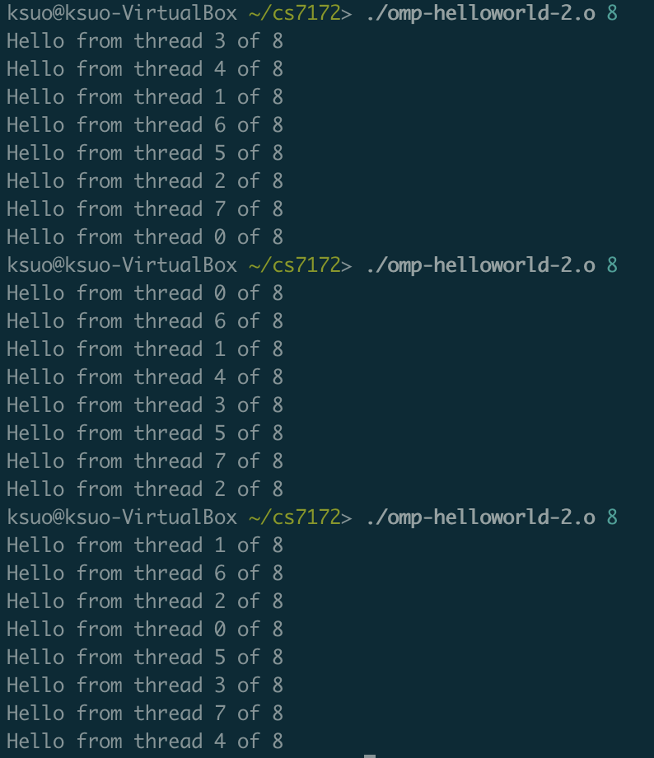
Example: #pragma omp parallel num_threads(thread_count)
Compile
gcc -fopenmp -o omp-helloworld-2.o omp-helloworld-2.c

Slide 23
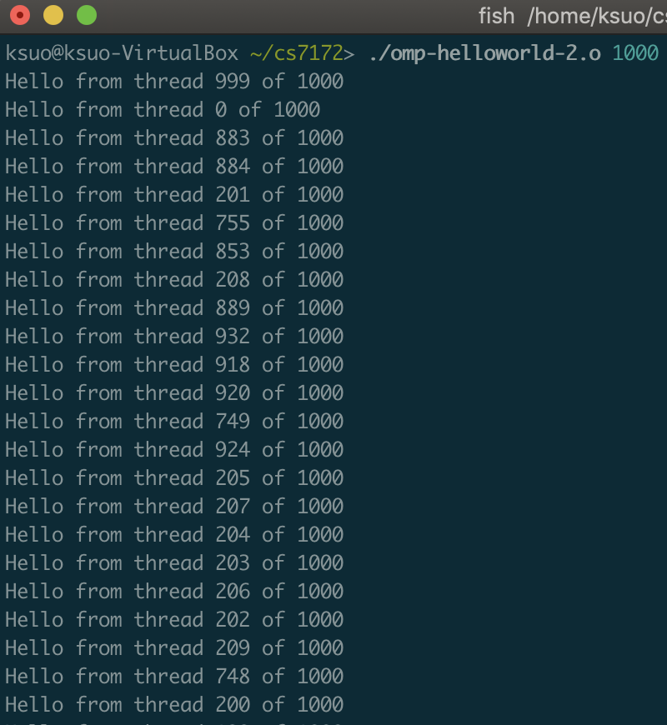
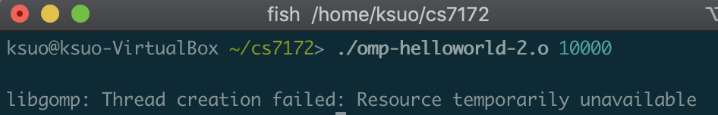
Of note…
10000 threads fail!
Too many.

Slide 24
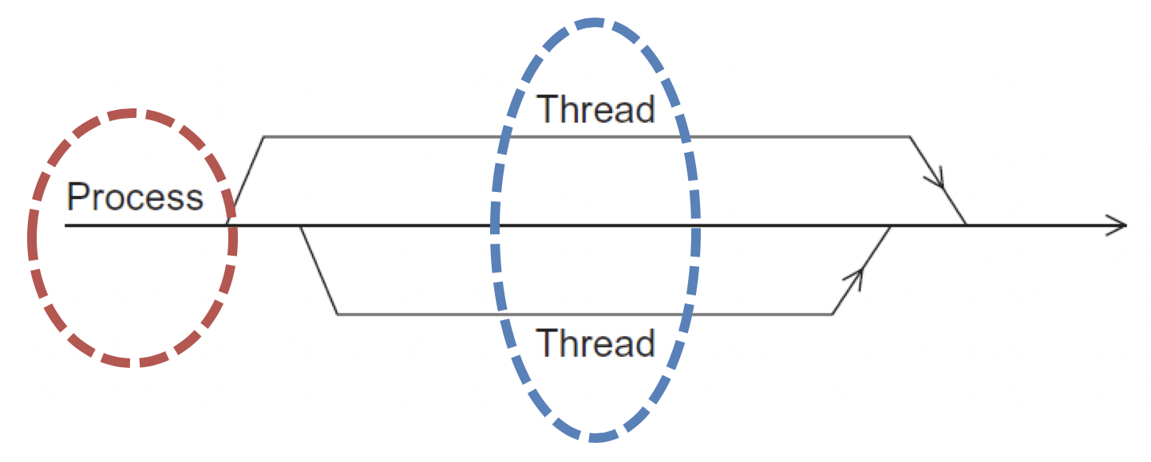

Some terminology
In OpenMP parlance the collection of threads executing the parallel block — the original thread and the new threads — is called a team, the original thread is called the master, and the additional threads are called worker.

Slide 25
In case the compiler doesn’t support OpenMP
# include <omp.h>
#ifdef _OPENMP
# include <omp.h>
#endif

Slide 26
In case the compiler doesn’t support OpenMP
# ifdef _OPENMP
int my_rank = omp_get_thread_num ( );
int thread_count = omp_get_num_threads ( );
# else
int my_rank = 0;
int thread_count = 1;
# endif

Slide 27
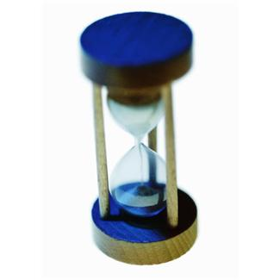
Performance evaluation

Slide 28
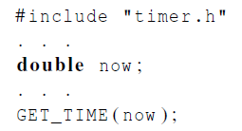

Elapsed serial time
In this case, you don’t need to link in the MPI libraries.
Returns time in microseconds elapsed from some point in the past.

Slide 29
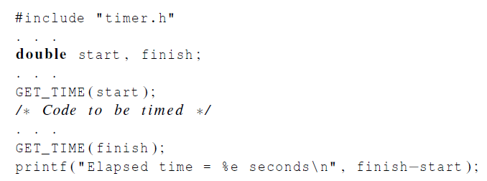
Elapsed serial time

Slide 30
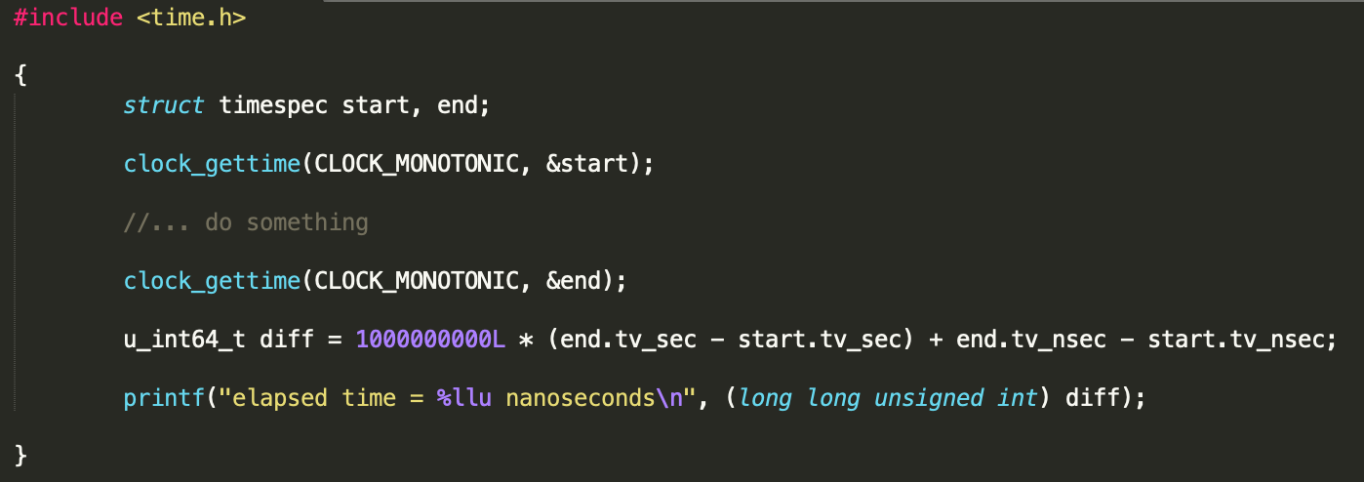
Elapsed serial time in nanoseconds

Slide 31
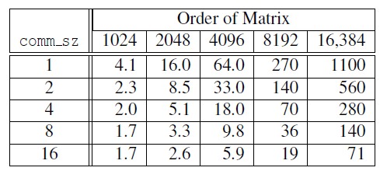
Run-times of serial and parallel matrix-vector multiplication
(Seconds)

Slide 32
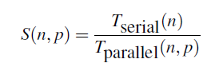
Speedup

Slide 33
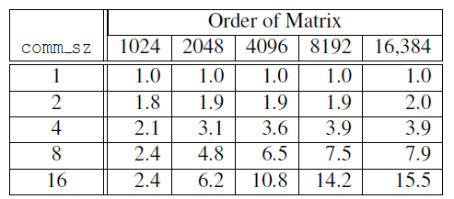
Speedups of Parallel Matrix-Vector Multiplication

Slide 34

The Trapezoidal Rule

Slide 35
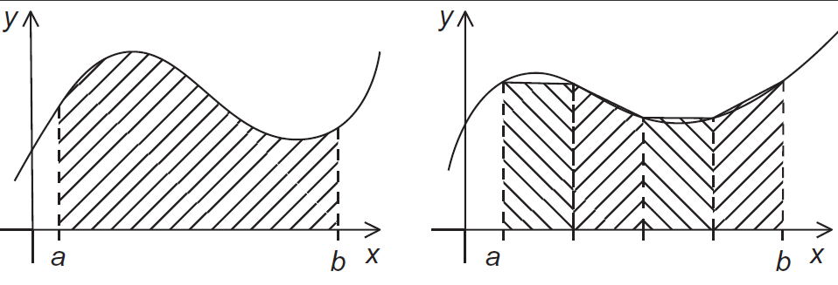
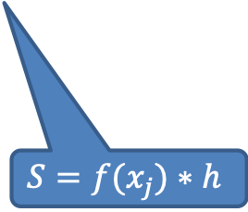
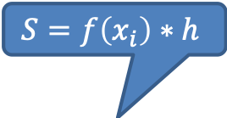
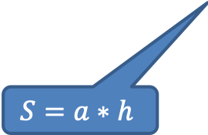
The trapezoidal rule
$$S=f\left(x_{i}\right)∗h$$
x_{i}
x_{j}
$$S=a∗h$$
h
$$S=f(x_{j})∗h$$
Here we used rectangle size to approximate calculate the size of trapezoid

Slide 36
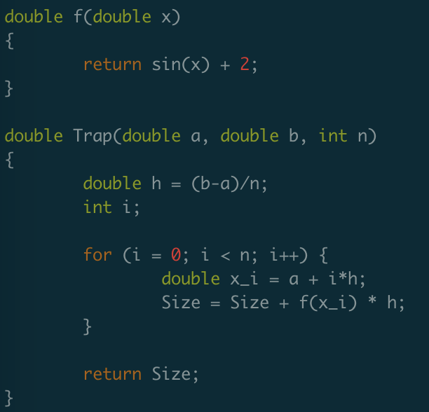
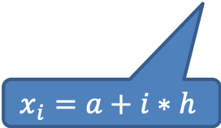
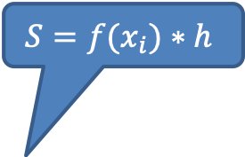
Serial algorithm
https://github.com/kevinsuo/CS7172/blob/master/trapezoidal-serial.c
$$S=f(x_{i})∗h$$
h
$$x_{i}=a+i∗h$$

Slide 37


A First OpenMP Version
1) We identified two types of tasks:
a) computation of the areas of individual trapezoids, and
b) adding the areas of trapezoids.
2) There is no communication among the tasks in the first collection, but each task in the first collection communicates with task 1b.
$$(a)$$
$$(b)$$

Slide 38
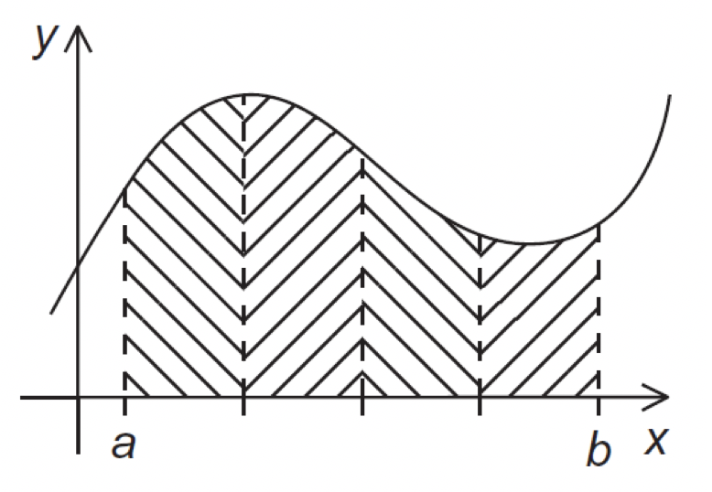

Rank = 1
Rank = 2
(a) To (a)
no communication
Rank = n
(a) To (b)
communication
Rank = 0

Slide 39
A First OpenMP Version
3) We assumed that there would be many more trapezoids than cores.
So we aggregated tasks by assigning a contiguous block of trapezoids to each thread (and a single thread to each core).

Slide 40
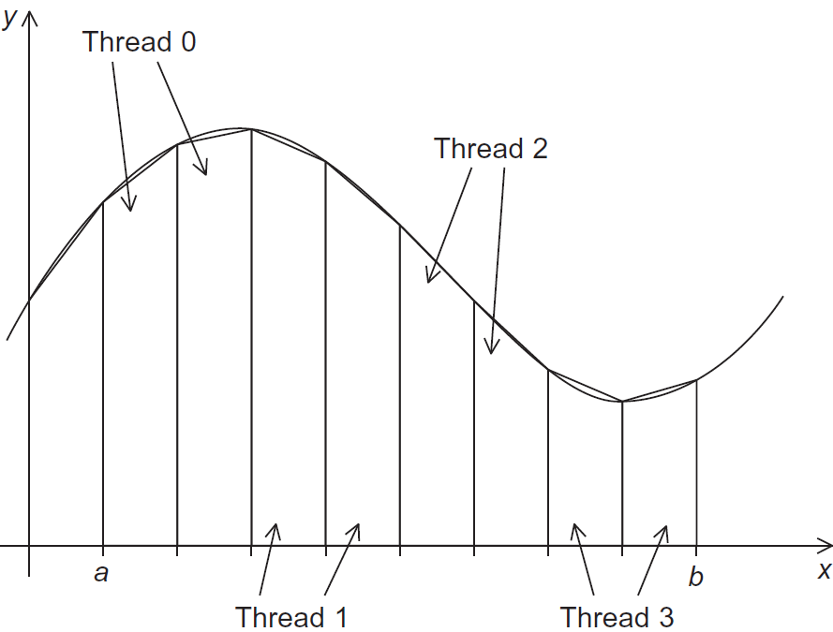
Assignment of trapezoids to threads

Slide 41

Unpredictable results
Unpredictable results when two (or more) threads attempt to simultaneously execute:
Size = Size + f(x_i) * h ;

Slide 42
Rank = 1
Rank = 2
(a) To (a)
no communication
Rank = n
(a) To (b)
communication
Rank = 0

Slide 43
Mutual exclusion
# pragma omp critical
Size = Size + f(x_i) * h ;
only one thread can execute
the following structured block at a time

Slide 44
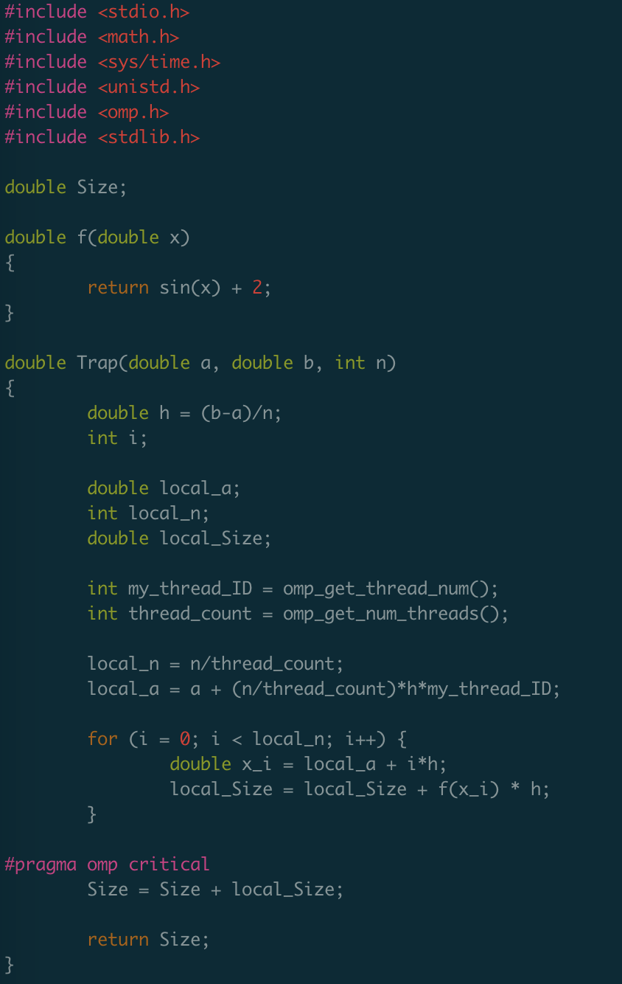

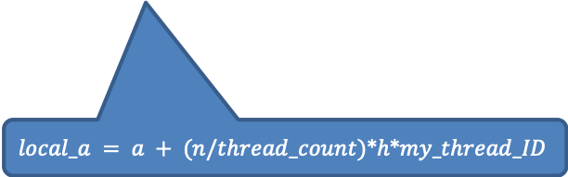
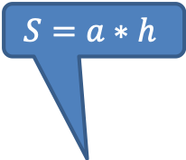
OpenMP Version
https://github.com/kevinsuo/CS7172/blob/master/trapezoidal-omp.c
$$S=a∗h$$
Task (a)
$$local_n = n/thread_count$$
$$local_a = a + (n/thread_count)∗h∗my_thread_ID$$
Task (b)

Slide 45
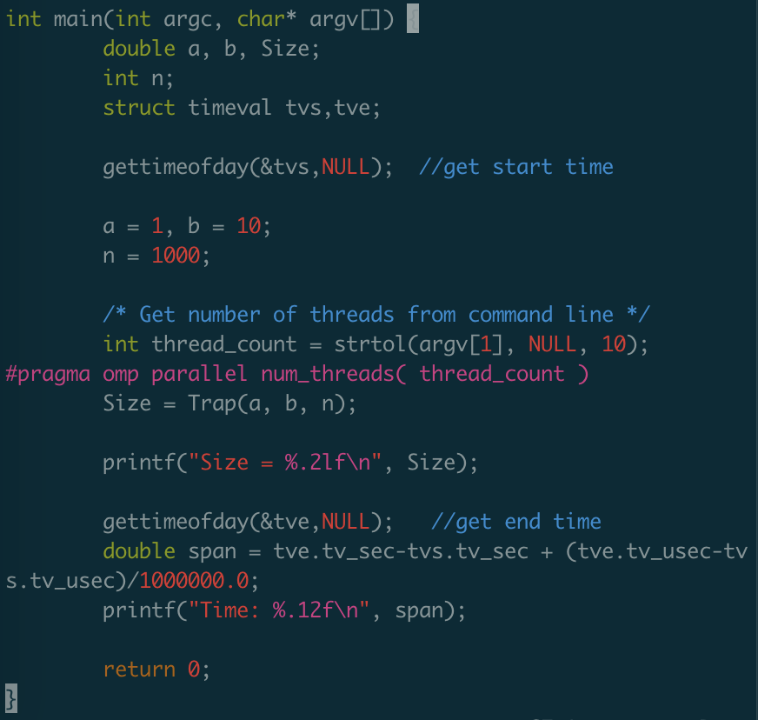
OpenMP Version
https://github.com/kevinsuo/CS7172/blob/master/trapezoidal-omp.c
$$S=a∗h$$
$$local_n = n/thread_count$$
$$local_a = a + (n/thread_count)∗h∗my_thread_ID$$

Slide 46
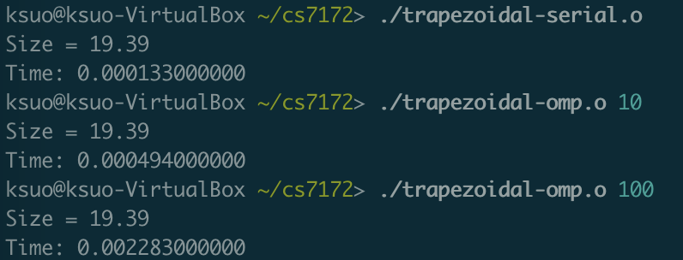
OpenMP Version
Sometime the overhead of synchronization is larger than the benefit of parallelism

Slide 47
Conclusion
OpenMP introduction
Helloworld of OpenMP
Performance evaluation
Example: how to solve problems in OpenMP
Trapezoidal problem

